Slide 1
Cybersecurity
Cybersecurity technology and best practices protect critical systems

Slide 2
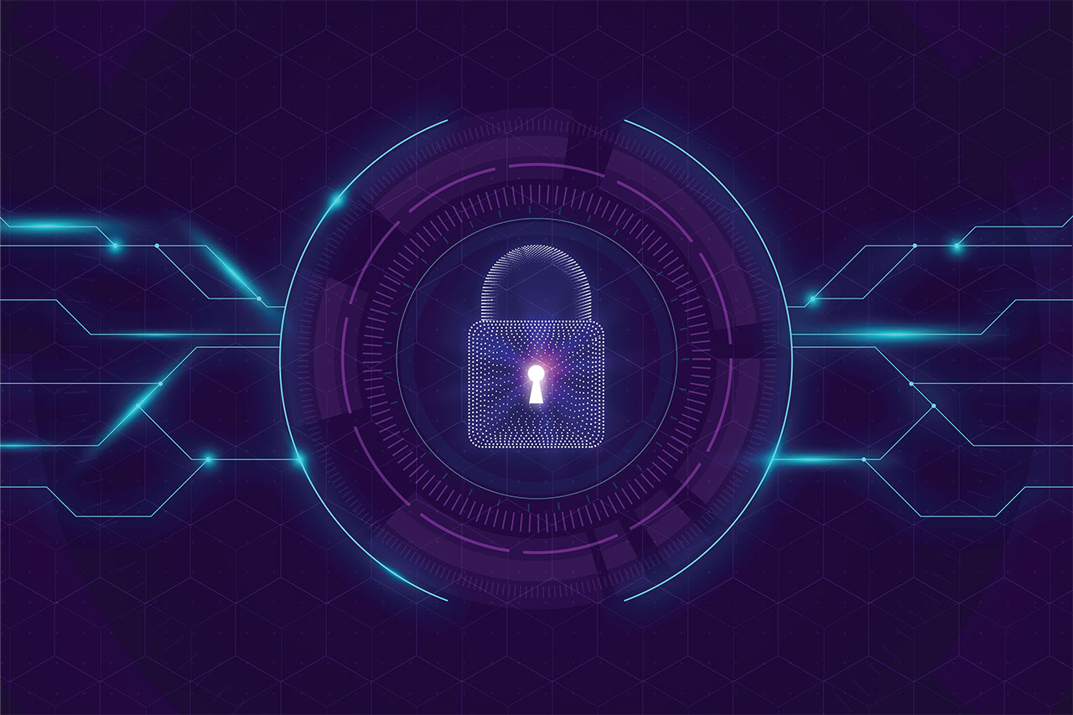
What is cybersecurity?
Cybersecurity is the practice of protecting systems, networks, and programs from digital attacks. These cyberattacks are usually aimed at accessing, changing, or destroying sensitive information; extorting money from users; or interrupting normal business processes.
Implementing effective cybersecurity measures is particularly challenging today because there are more devices than people, and attackers are becoming more innovative.

Slide 3
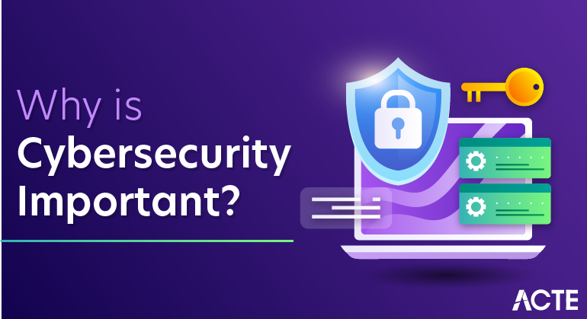
Why is cybersecurity important?
Why is cybersecurity important? In today’s connected world, everyone benefits from advanced cyberdefense programs. At an individual level, a cybersecurity attack can result in everything from identity theft, to extortion attempts, to the loss of important data like family photos.
Everyone relies on critical infrastructure like power plants, hospitals, and financial service companies. Securing these and other organizations is essential to keeping our society functioning.

Slide 4
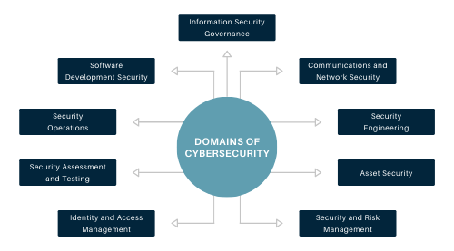
Cybersecurity domains
A strong cybersecurity strategy has layers of protection to defend against cyber crime, including cyber attacks that attempt to access, change, or destroy data; extort money from users or the organization; or aim to disrupt normal business operations.

Slide 5
Types of cybersecurity threats
Phishing
Distributed denial-of-service (ddos) attack
Malware
Ransomware
Insider threats
Man-in-the-middle attacks
Advanced persistent threats(APT)
Social engineering

Slide 6
Phishing
Phishing is a form of social engineering that tricks users into providing their own PII or sensitive information. The aim is to steal sensitive data like credit card numbers and login information. It’s the most common type of cyber attack. You can help protect yourself through education or a technology solution that filters malicious emails.
In phishing scams, emails or text messages appear to be from a legitimate company asking for sensitive information, such as credit card data or login information. The FBI has noted about a surge in pandemic-related phishing, tied to the growth of remote work.

Slide 7
Using phishing was spread the following viruses
MyDoom - the most destructive virus in the world, that caused about $ 38 billion in damage.
Chornobyl - virus, that destroyed data from the hard drives of infected computers.
WannaCry - a virus that encrypts many files stored on a disk using the RSA-2048 algorithm and demands a ransom for them in bitcoin equivalent, and many others.
NotPetya - a virus that when you try to get rid of it deletes all data from your computer along with the operating system without the ability to recover.

Slide 8
Distributed denial-of-service (DDoS) attack
A DDoS attack attempts to crash a server, website or network by overloading it with traffic, usually from multiple coordinated systems.
DDoS attacks overwhelm enterprise networks via the simple network management protocol (SNMP), used for modems, printers, switches, routers, and servers.

Slide 9
Malware:
The term “malware” refers to malicious software variants—such as worms, viruses, Trojans, and spyware—that provide unauthorized access or cause damage to a computer.
Malware attacks are increasingly “fileless” and designed to get around familiar detection methods, such as antivirus tools, that scan for malicious file attachments.

Slide 10
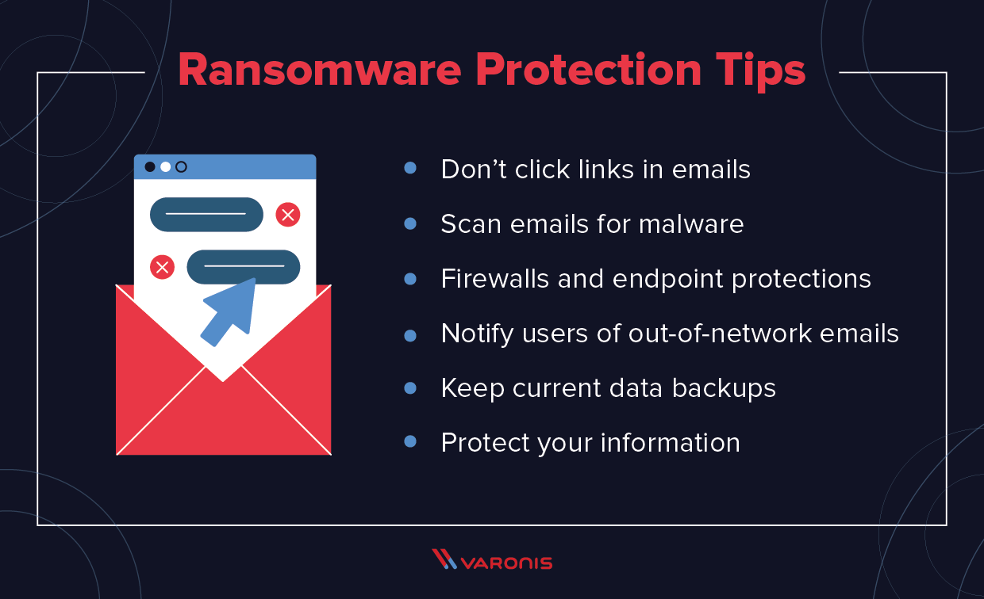
Ransomware
Ransomware is a type of malware that locks down files, data or systems, and threatens to erase or destroy the data - or make private or sensitive data to the public - unless a ransom is paid to the cybercriminals who launched the attack.

Slide 11
Insider threats
Current or former employees, business partners, contractors, or anyone who has had access to systems or networks in the past can be considered an insider threat if they abuse their access permissions.
Insider threats can be invisible to traditional security solutions like firewalls and intrusion detection systems, which focus on external threats.

Slide 12
Man-in-the-middle attacks
Man-in-the-middle is an eavesdropping attack, where a cybercriminal intercepts and relays messages between two parties in order to steal data.
For example, on an unsecure wi-fi network, an attacker can intercept data being passed between guest’s device and the network.

Slide 13
Advanced persistent threats(APT)
In an Advanced persistent threats, an intruder or group of intruders infiltrate a system and remain undetected for an extended period. The intruder leaves networks and systems intact so that the intruder can spy on business activity and steal sensitive data while avoiding the activation of defensive countermeasures.
The recent Solar Winds breach of United States government systems is an example of an APT.

Slide 14
Social engineering
Social engineering is a tactic that adversaries use to trick you into revealing sensitive information. They can solicit a monetary payment or gain access to your confidential data.
Social engineering can be combined with any of the threats listed above to make you more likely to click on links, download malware, or trust a malicious source.

Slide 15
Some interesting facts
The first cybercrime was recorded in the year 1820
The first spam email took place in 1978 when it was sent over the Arpanet
The first virus was installed on an Apple computer in 1982

Slide 16
Conclusion
Nowadays, it is very important to protect your data on the Internet from attackers, so we have told you about their most common methods so that you know about them and do not fall for them.

Slide 17
Thanks for your attention
Arsen polivka
NAZAR YURAS

